Slide 1


Hava Havai App Analysis: User Flow, Metrics Funnel, and Growth Plan
This presentation will examine the Hava Havai app's user journey, analyze key performance metrics, and propose a growth plan to increase user acquisition.
by rudransh sharma

Slide 2
1. User Flow Analysis
Mapping the Journey
Identifying Pain Points
We'll map the end-to-end user journey from app download to booking a flight. We'll identify key touchpoints, such as onboarding, flight search, and payment and standout elements like easy of searching ,flights view etc.
By analyzing user behavior, we'll pinpoint areas where users experience friction or confusion. We'll prioritize suggestions for improvement.

Slide 3

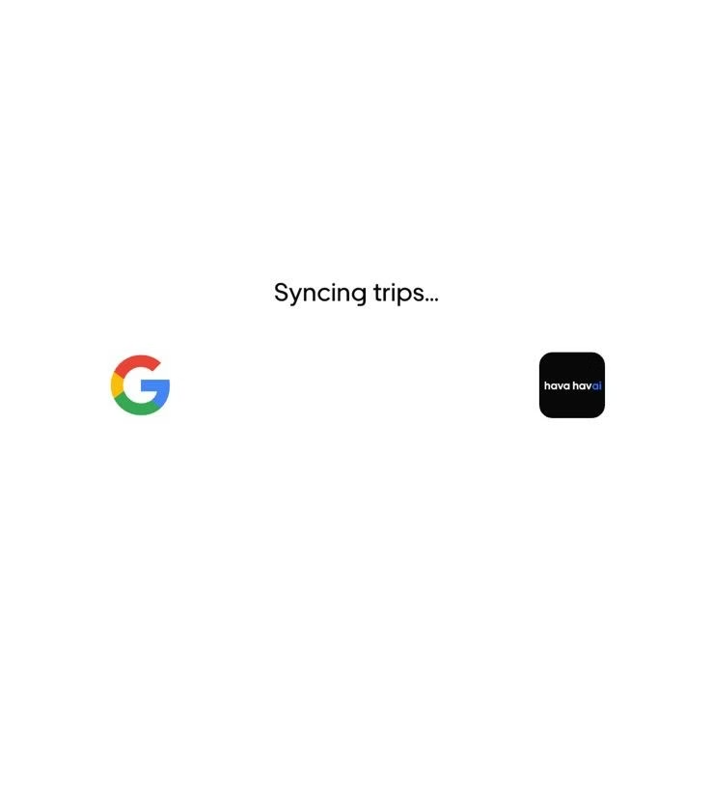
1. Login and Onboarding
Seamless Login
Personalized Onboarding
The app offers a variety of login options, including email, Google, and Apple accounts. This enhances user convenience.
A simple onboarding process is crucial. We'll evaluate if onboarding is personalized and guides users effectively.

Slide 4

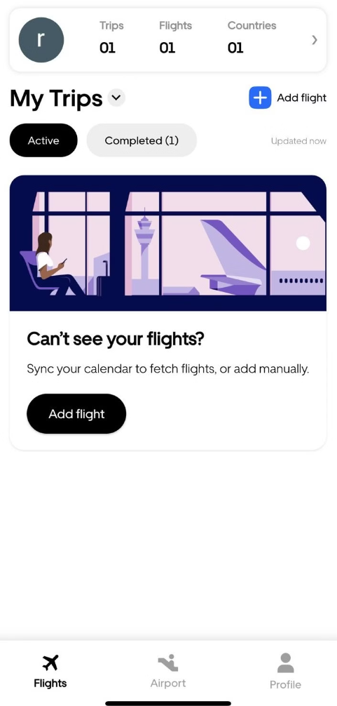
1.1 Dashboard View
1
Standout Elements
Comprehensive Metrics: Displays total trips, flights, and countries visited in a concise, professional format.
d
Trip Status Overview: Differentiates between active and completed trips, ensuring clear insights.
User-Friendly Design: Organized layout for quick access to essential travel data.

Slide 5

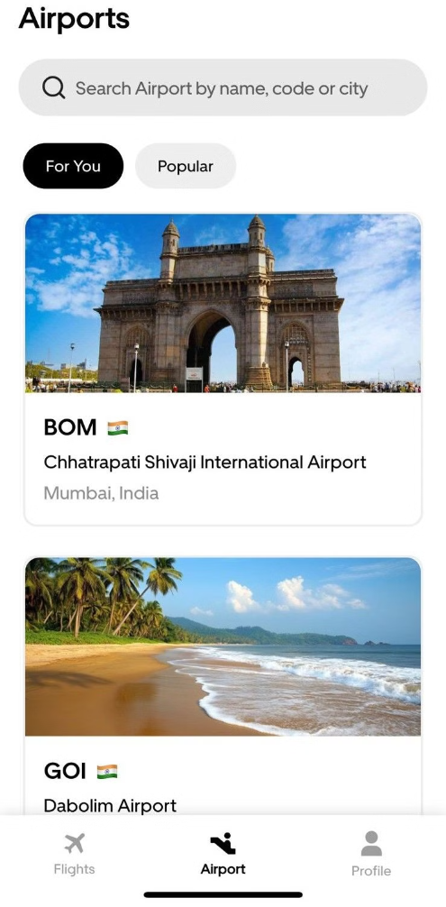
1.3. Airports View
1
Standout Element
2
Friction-point
Airport Recommendation
The application experiences delays when loading airport search results and lacks cab service availability across all countries, impacting user convenience and global usability.
Airport Info including lounge facility and airport contact number.
Cab Service Availability

Slide 6
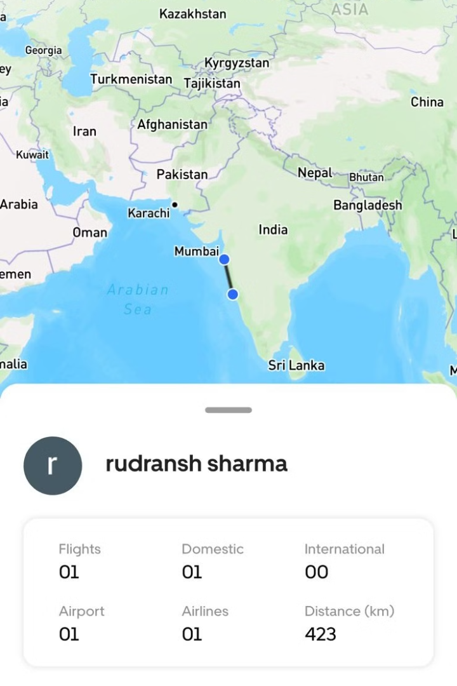
1.4 Detailed Profile and Booking
1
Standout Element
2
Friction-point
Provides a detailed overview of flights, distinguishing between domestic and international travel, including airports, airlines, and total distance covered for comprehensive insights.
A feature can be added allowing customers to click on airlines and view their Airlines history like name of the airlines they have travelled in till now same in domestic and international flights, for enhanced insights and convenience.

Slide 7
2. Growth Plan
1
Goal: 5X Growth
Organic Growth
2
Improve app store optimization by, content marketing, and social media engagement which lead to more downloads more reviews and ratings.
Referral Programs
3
Implement a referral program that incentivizes users to recommend the app to their friends and family.
Partnerships
4
Explore partnerships with travel agencies, airlines, and other relevant businesses.
Engagement Tactics
5
Develop engaging features like flight bookings which can lead to more engagement personalized recommendations, and content to retain users.

Slide 8




2. Metrics Funnel
1
Download
Onboarding
2
Users complete the onboarding process and set up their profiles.
Flight Search
3
Users start searching for flights using the app's filters and options.
Overall history
4
Users return to the app to see bookings, history use app features, and engage with content.

Slide 9

4. Data-Driven Insights
1
User Flow Analysis
2
Metrics Funnel
3
Growth Strategies

Slide 10

Conclusion: Moving Forward
By focusing on user experience improvements by working on friction points , data-driven decision-making, and strategic growth initiatives like adding new features , social media and online growth we can ensure the continued success of the Hava Havai app. The app's future is bright, filled with opportunities for growth and positive user impact.

